Slide 1
Research on Acids
Name
Institution of Affiliation

Slide 2
Introduction
An acid is a substance that deionize or dissociates in water to yield hydrogen ions or alternatively capable of forming a covalent bond with an electron pair.
based on the definition there above, there are two categories of acids they hydrogen ion or proton yielders i.e. Bronsted acids and the covalent bond formers i.e. the Lewis acids.
Acids have different strengths with regard to their dissociation in water; there are strong and weak acids. Strong acids dissociates completely in water while weak acids partially dissociates in water.

Slide 3
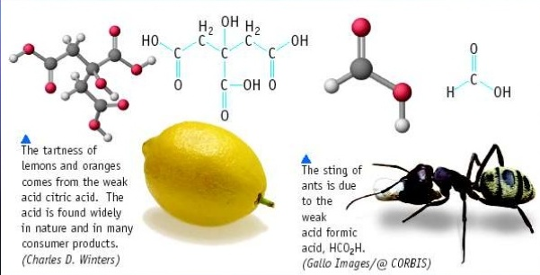
Introduction cont…
Examples of strong acids are nitric acid, sulphuric acid, and hydrochloric acid, among others. examples of weak acids are carbonic acid, acetic acid, and hydrofluoric acid, among others. Acids in Everyday life

Slide 4
Properties of Acids
Physical properties
  Acids corrode metals
  They have a sour taste
  They have a ph of <7
  They turn blue litmus paper blue
  They conduct electricity
  They have a stinging feeling
Chemical properties
Acids react with metals to form salt and hydrogen gas
METAL + ACID SALT + HYDROGEN GAS
Example: Magnesium ribbon with dilute hydrochloric acid
Mg (s) + HCl (aq) MgCl2 (aq) + H2 (g)

Slide 5
Properties of Acids cont…
Acids react with carbonates to form salt, carbon (iv) oxide, and water
ACID + CARBONATE SALT + CARBON (iv) OXIDE +WATER
Example: dilute hydrochloric acid with sodium carbonate
HCl (aq) + Na2CO3 (aq) NaCl (aq) + CO2 (g) + H2O (l)
Acids react with metal oxides and metal hydroxides to form salt and water only
ACID + METAL OXIDE SALT + WATER
ACID + METAL HYDROXIDE SALT + WATER

Slide 6
Ph Definition
pH is the measure of the hydrogen ion concentration in a solution. It is also defined as the measure of the acidity or the alkalinity of a solution.
pH is measured by a pH meter which uses a pH scale that ranges from 0 to 14. solutions with pH of less than 7 are acids, solutions with pH of more than 7 are bases, and solutions with a pH of 7 are Neutral.
Accurate measurement of the activity of hydrogen ions for most solutions has been difficulty and this prompted the International Union for Pure and Applied Chemistry to redefine pH as the reading of a pH meter that has standardized with standard buffers.

Slide 7
Sulphuric acid
Sulphuric acid is an example of a solution that displays acidic properties. This is a mineral acid made of sulfur, oxygen, and hydrogen as the constituent elements. Mineral acids are derived from inorganic elements.
It is a highly dehydrating and oxidizing acid, especially when in high concentration. It is also hygroscopic, readily taking up water when exposed to the atmosphere.
The acid is an essential substance in the chemical industry and in the U.S alone, 40 million tons of sulfuric acid are produced every year mainly through the contact process.

Slide 8
Sulphuric Acid Production Process
Large scale production of sulfuric acid is done through the contact process where the substance is generated in high concentrations as needed by chemical industries.
This process was patented by Pelegrine Philips, a British vinegar merchant in 1831.
The process was accepted by chemists as it was more efficient than other production processes and used the less poisonous and inexpensive vanadium (v) catalyst. In addition, the process yields, oleum and sulfur trioxide.
The production process follows through five steps.

Slide 9
Sulphuric acid Production Cont…
The initial step in the production process involves combination of sulfur and oxygen to form sulfur (iv) oxide
Next, sulfur (iv) oxide is passed through a purification unit to avoid poisoning the vanadium (v) catalyst.
Excess oxygen is then added to the sulfur (iv) oxide in the presence of vanadium (v) oxide catalyst at 450 degrees and 1-2 atmospheres.
The sulfur (vi) oxide formed is mixed with pure sulfuric acid to generate oleum (disulfuric acid).
The oleum is then diluted with water to form sulfuric acid

Slide 10
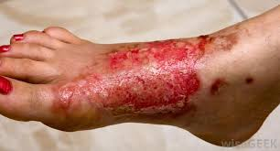
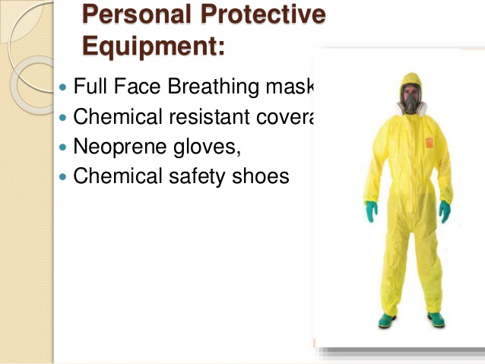
Safety Concerns of Sulphuric Acid
Sulfuric acid is a highly corrosive acid with it causing burns to the skin as shown in the burnt foot. Workers in the acid’s production plant ought to wear protective gears that covers every part of their body.
Inhalation of sulfuric acid fumes causes chest pains, coughing, shortness of breath, and lung diseases, among other health concerns.
When waste gases from its production process find their way into the atmosphere, they cause acid rain, which corrode buildings and metal structures. Lakes and rivers also become acidic and this threatens the aquatic life.

Slide 11
Uses of Sulphuric acid
In its industrial application, sulfuric acid is used in the manufacture of fertilizers, pharmaceuticals, gasoline, automobile batteries, sulfonation agents, steel manufacturing, bleaching agents, and regeneration of ion exchange resin.
In the production of fertilizers, sulfuric acid is mixed with a phosphate rock and a reaction occurs producing phosphoric acid. This acid is crystallized in a form that can be safely handled and easily absorbed by plants. Ammonium sulfate is another fertilizer that is made using sulfuric acid.
As a component in car batteries, it reacts with lead to generate power that is necessary to start the engine system of the care
With its potent bleaching ability, sulfuric acid is used in dry cleaners. However, spills from the device can cause serious burns if the handler of the machine is unprofessional.

Slide 12
Uses of Sulfuric acid Cont…
In households, sulfuric acid is used to remove rust, oxidation residues, and scaling from steel and iron devices before they are sold to automobile industries.
A mixture of hydrogen peroxide and sulfuric acid piranha solution, a solution that is very poisonous but an effective cleaning agent that is used to clean glassware in laboratories.
The concentration of sulfuric acid also determines its possible uses. Due its high affinity to water, concentrated sulfuric acid is used as a drying agent , especially in the laboratory preparation of gases. In its dilute form, sulfuric acid is used as an electrolyte in car batteries.

Slide 13
References
Cox, B. G. (2015). Acids, bases, and salts in mixed-aqueous solvents. Organic Process Research & Development, 19(12), 1800-1808.
Lykke, M., Sverdrup, R. and Thellefsen, M., Haldor Topsoe AS, 2018. Process for production of sulfuric acid. U.S. Patent Application 15/572,297.
Pan, H., & Henriques, L. (2015). Students' Alternate Conceptions on Acids and Bases. School Science and Mathematics, 115(5), 237-243.
Timberlake, K. C. (2015). Chemistry: an introduction to general, organic, and biological chemistry. Pearson.

